Slide 1
Data Science
Musadaq Mansoor

Slide 2
What is Data Science
Data Science is a blend of various tools, algorithms, and machine learning principles with the goal to discover hidden patterns from the raw data.

Slide 3
Data Science Life Cycle
Question
Acquire
ETL
Wrangling
Visualize
Choose
Build
Validate
Deploy
Test
Story Telling

Slide 4
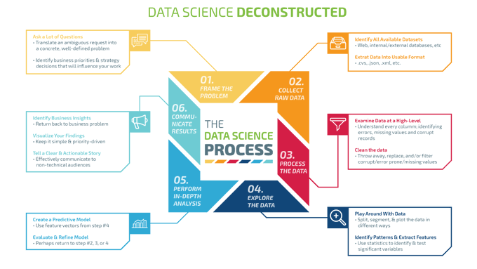

Slide 5
Python
The tools / libraries available in python can cover all the steps of Data Science
Acquire: BeautifulSoup, Lxml
Data Wrangling: Pandas
Visualize: Matplotlib
Machine Learning: Tensorflow, Keras

Slide 6
Thanks
Any Questions?

